Slide 1
Welcome Back to
Money Basics
A peer-led, person-directed, and strengths-based
financial empowerment training for individuals who experience mental health and/or addiction challenges

Slide 2
Debt & Tools to Get Out of It
Workshop 7
pg. 118 in student guide

Slide 3
Welcome Back!
Updates & Sharing:
How did the money saving homework go?
How are your budgets going?
What interest rates on debts/loans did you find?
Today’s Agenda:
Identify how we feel about debt now, and how we’d like to feel in the future
Determine how much we owe and calculate our debt-to-income ratios
Learn about different methods to organize debt payoffs
Learn about bankruptcy and the pros and cons
Create an action plan for paying off debts

Slide 4
Community Agreement

Slide 5
Learning Objectives
Learning Objectives:
Upon conclusion of Workshop 7, participants will:
Have a better understanding of how personal debt affects them
Have calculated how much debt they owe and what the interest rates and actual costs are of their various debts
Have learned options and payment methods for their debt and their pros and cons
Have created a workable plan for reducing their debt

Slide 6
Thoughts on Debt
When you think about debt, what kinds of feelings does this bring up for you?
How would you like to feel about debt? Where would you like to be in one year? In three?

Slide 7
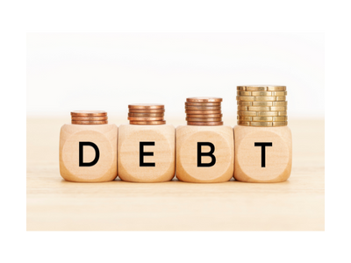
Figuring Out How Much You Owe
Homework Review: Tallying Up Debts
Step 1: Check Your Credit Reports
Step 2: Gather Any Missing Information
Step 3: Compare
Step 4: Create a List of Current Debts

Slide 8
Debt to Income Ratio
What is your Debt-to-Income Ratio?
How much you owe vs. how much you make
Measures your ability to make current debt payments
Step 1: Calculate your monthly debt
Step 2: Add up your total gross monthly income
Step 3: Divide your total monthly debt by your total monthly income
Monthly debt: | $
Monthly income: | $
Debt to income ratio: | ____%

Slide 9
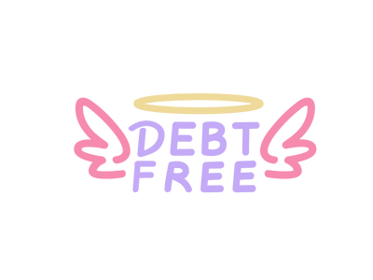
The Long-Term Strategy
Order your debts by the longest term (length) of the debt and pay off whichever will cost more throughout the length of the debt. Work your way from most expensive to least.
Goal: Pay the least amount over the course of years, rather than worrying about month-to-month costs. This should reduce the overall interest you pay.
The Long-Term Strategy & Credit Card Debt:
Paying credit card debt is a common example of the long-term strategy
The key to paying down credit card debt: Pay as much over the minimum as possible so your payment goes towards the principal rather than interest

Slide 10
Interest-Rate & Month-to-Month Strategies
The Interest Rate Strategy:
Pay off the debts with the highest interest rates first, working your way from the bills with the highest rates to those with lower rates
Goal: Reduce the long-term effects of interest
The Month to Month Strategy:
Organize your monthly debts by whichever is easiest to pay off
Goal: Reduce the amount you pay each month
Note: This is a short-term fix for larger debt problems

Slide 11
The “Snowball” & the “avalanche” Technique
Debt Snowball:
List your debts in order from lowest balance to largest. Don’t pay attention to interest rates.
Put extra money towards your smallest debt, while continuing to make minimum payments on all your other debts, and work your way up.
Once you’ve paid the smallest debt off, move on to the next smallest, and so on, working your way through your list.
Continue “snowballing” your debt payments until they are all paid off!
Debt Avalanche:
List your debts in order from the highest interest rate to the lowest. Don’t pay attention to the balance.
Put extra money toward the debt with the highest interest rate, while continuing to make minimum payments on your other debts.
You will start at the top and work your way down, focusing on the next-highest interest rate, and so on.
Continue this “avalanche” of debt payments until all your debts are paid off!

Slide 12
Additional Options for Paying Off Debt
Debt consolidation loan or debt management plan
Merging multiple loans into one – you make monthly payments to one lender and they pay off your existing debts
Taking out a second loan
Get a new loan and use that to pay off an old one
Credit counseling
Can help you to negotiate payments, fees, and interest rates with your creditors
Debt settlement
Negotiating with a creditor to reduce the amount of the principal you still owe
File for Bankruptcy
Petition in court for your debts to be discharged

Slide 13
Pros & Cons of Bankruptcy
Benefits
Drawbacks
Stops all collection actions by creditors
Most states exempt your home, car, and other essential assets
Can get you started on rebuilding your credit sooner
Can prevent your lenders from aggressive collection action
You will lose all your credit cards
You will likely lose luxury possessions
It will be nearly impossible to get a mortgage for 5 years
Stays on your credit report for 10 years, which can make it difficult to get a credit card or loan
Not all debts may be discharged in a bankruptcy

Slide 14
Action Plan for Paying Off Debts
Which monthly debt? | How much is still owed? | What is the interest rate? | Payment option: | When will it be paid off? | How will it be paid off?
Credit card #1 | $500 | $14% | Long-term strategy + Snowball Method | In 6 months | This is my smallest debt (Snowball Technique). I will pay over the minimum each month on this bill, while continuing to make minimum payments on my other debts. Once this bill is paid off, I’ll focus on my car loan (my next largest debt).

Slide 15
Wrap-Up
Thank you all for your participation today!
Are there any questions?
Homework:
Choose one more money saving idea and commit to it for the week. Keep track of which ideas are going well and which are not.
Commit to using your personalized budget for the next week.

